Slide 1


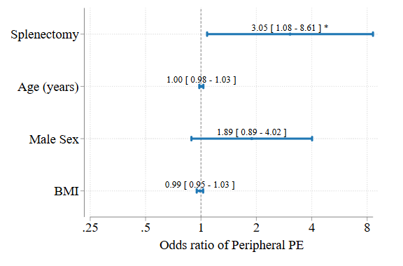
Splenectomy Is Associated with Peripheral PE Location, Implications for CTEPH Pathogenesis
Darren White, MD¹, Brian W Locke, MD MSc², Kaan Raif, MD³, Mark Dodson, MD PhD²
¹ University of Utah Pulmonary and Critical Care Fellowship, ² Intermountain Medical Center Department of Pulmonology and Critical Care
³ University of Utah Division of Internal Medicine Residency
Independent Predictors of PE Location
Rationale
Splenectomy associates with chronic thrombembolic pulmonary hypertension (CTEPH) more strongly than with venous thromboembolism (VTE).
Differences in the location or clot burden at acute PE diagnosis might help explain the excess CTEPH risk associated with splenectomy, but have not been previously characterized.
Methods
Retrospective, matched cohort study of patients admitted for PE ± prior splenectomy at a quaternary referral center in Utah.
Independent, duplicate physician review of CT imaging to determine:
Qanadli index (measure of clot burden)
Central (lobar or main PA) vs. peripheral (segmental or subsegmental PA) location of most proximal clot.
High agreement between CT reviewers (Cohen’s κ = 0.71).
Results
Splenectomy independently associated with peripheral PE (adjusted odds ratio: 3.05 [1.1-8.6], P = .035).
No difference in PE burden (based on Qanadli score, P = .65) between groups.
Splenectomy group more like to have
2+ weeks of symptoms (P = .044)
no DVT at PE diagnosis (P = .002)
Discussion
Patients with splenectomy had more peripheral PEs, but similar clot burden and RV strain.
Patients with splenectomy more likely to present with longer PE symptom duration (>2 weeks), and less likely to have DVT found at PE presentation.
Splenectomy may predispose to:
Recurrent small volume venous thromboembolism
Origination of clot elsewhere than in deep veins of the extremities
Splenectomy patients have higher odds of peripheral PE compared with patients who have not had splenectomy (logistic regression controlling for relevant covariates).
 | No Splenectomy | Splenectomy | p-value
N | 100 | 40
Age at index PE | 61 (52,73) | 56 (41,66) | 0.013
Male Sex | 48% (48) | 35% (14) | 0.16
PE severity index (PESI) | 97 (75,120) | 89 (66,111) | 0.097
PA Enlargement (CT) | 71% (71) | 68% (27) | 0.68
RV to LV ratio (CT) | 1.07 (0.88,1.31) | 1.07 (0.94,1.35) | 0.31
RV to LV ratio abnormal (>1 by CT) | 55% (55) | 70% (28) | 0.10
Troponin (max) (ng/mL) | 0.01 (0.01,0.08) | 0.01 (0.01,0.03) | 0.067
BNP (max) (pg/mL) | 62 (18,306) | 49 (24,110) | 0.70
Peripheral PE | 37% (37) | 52% (21) | 0.093
Qanadli Score (Avg) | 0.22 (0.08,0.48) | 0.13 (0.06,0.34) | 0.32
Duration of Symptoms ≥ 2 weeks | 8% (8) | 20% (8) | 0.044
DVT within 2 weeks | 71% (48) | 35% (8) | 0.002
Splenectomy patients are younger, more likely to have >2 weeks of symptoms, and less likely to have DVT found within 2 weeks of PE (unadjusted comparisons using Wilcoxon rank sum for continuous variables and Chi-square for binary variables).

